Slide 1

Robot Dynamics & Control
a.a. 2021/22
Introduction to Assignment 1
-
Robot Statics and Parameters

Slide 2
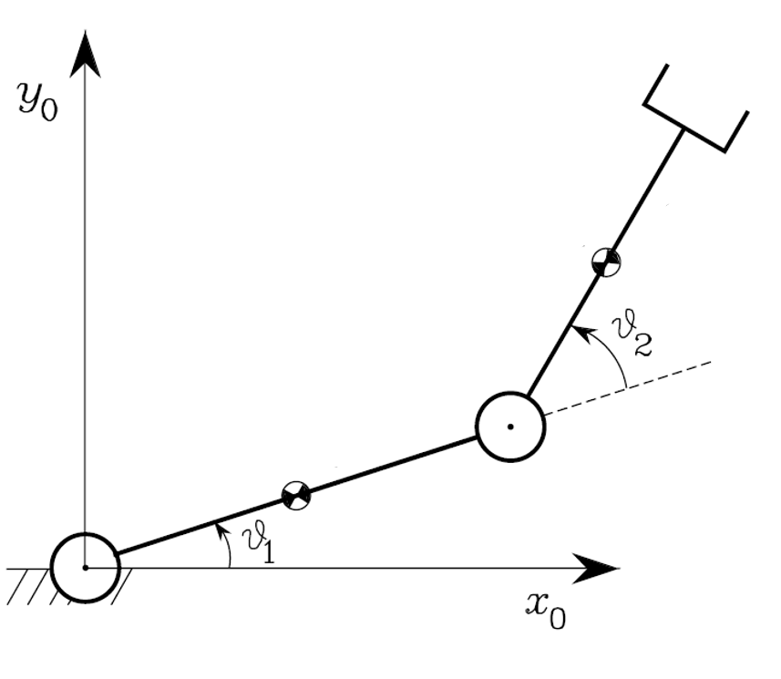
A dynamics perspective
A chain of rigid bodies connected by joints.
What kind of forces to deal with?

Slide 3
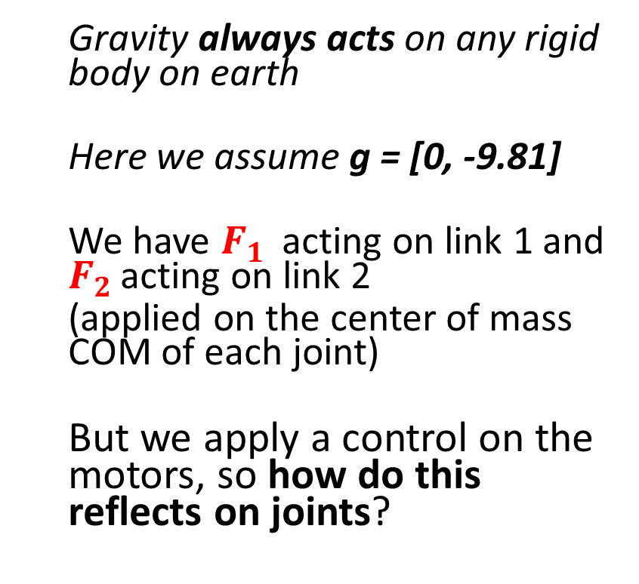


The gravity action
Gravity always acts on any rigid body on earth
Here we assume g = [0, -9.81]
We have $F_{1 }$ acting on link 1 and $F_{2 }$acting on link 2
(applied on the center of mass COM of each joint)
But we apply a control on the motors, so how do this reflects on joints?
$$F_{2 }=m_{2}g$$
$$F_{1 }=m_{1}g$$

Slide 4

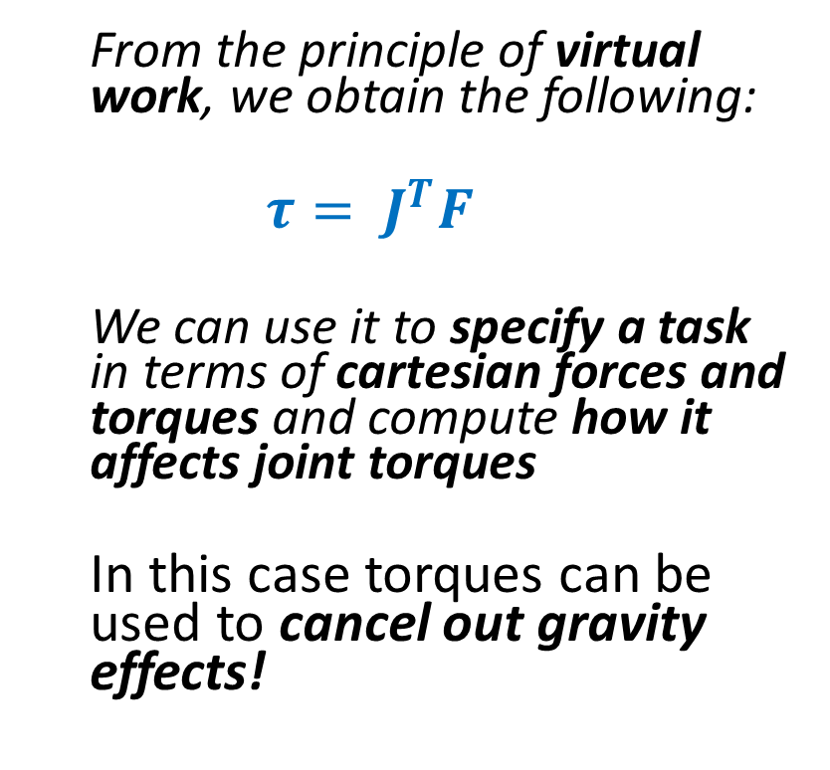

The gravity joint torques
From the principle of virtual work, we obtain the following:
$$τ= J^{T}F$$
We can use it to specify a task in terms of cartesian forces and torques and compute how it affects joint torques
In this case torques can be used to cancel out gravity effects!
$$τ_{2}$$
$$F_{2 }=m_{2}g$$
$$τ_{1}$$
$$F_{1 }=m_{1}g$$

Slide 5

An external force on COM
Nothing more that a physics problem
The robot can be controlled to resist to external forces….
…or to apply forces on the environment
$$F_{ext}$$
$$τ_{2}$$
$$F_{2 }=m_{2}g$$
$$τ_{1}$$
$$F_{1 }=m_{1}g$$

Slide 6

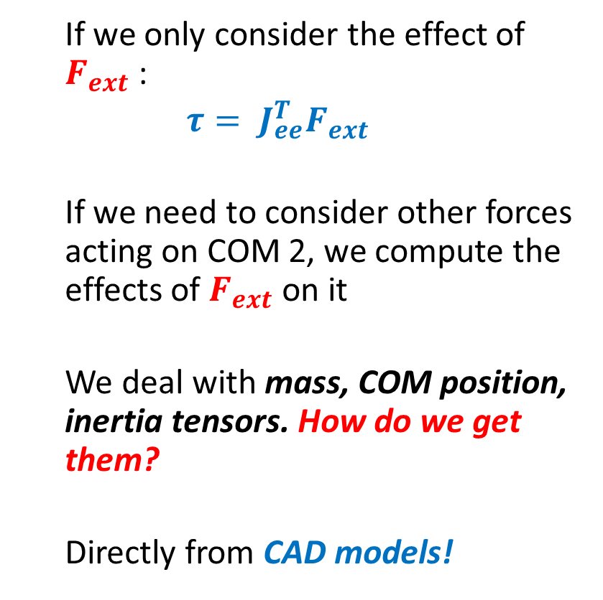


An external force at the end effector
If we only consider the effect of $F_{ext}$ :
$τ= J_{ee}^{T}F_{ext}$
If we need to consider other forces acting on COM 2, we compute the effects of $F_{ext}$ on it
We deal with mass, COM position, inertia tensors. How do we get them?
Directly from CAD models!
$$F_{ext}$$
$$τ_{2,ext}$$
$$F_{2,ext}$$
$$τ_{2}$$
$$F_{2 }=m_{2}g$$
$$τ_{1}$$

